Slide 1
Gary Guo
Case Manager Development
2014-Sep-02
Product Implementation Training (PIT)
IBM Case Manager 5.2.1
Solution Development Improvements: To Do Lists

Slide 2
Introduction
Course Overview
This course will introduce the new To-do List feature added in IBM Case Manager 5.2.1
Target Audience:
IBM support, service and technical sales
Solution developers
Prerequisites:
Experience with IBM Case Manager 5.2
Version Release Date: September, 2014
© Copyright International Business Machines Corporation 2014. All Rights Reserved.
US Government Users Restricted Rights - Use, duplication or disclosure restricted by GSA ADP Schedule Contract with IBM Corp.

Slide 3
Course Objectives
After this course you will be able to:
Describe how the To-do list can help you build Case Manager solutions that use non-process tasks.
Create and configure To-do tasks in Case Builder.
Configure the To-do list widget in Case Builder.
Customize the To-do List widget using the events or API.

Slide 4
Course Roadmap
Overview
Configure To-do task in Case Builder
To-do List widget
Customization/API Overview
Course Summary

Slide 5
Overview
To-do is a new task type to support some simpler use cases that don’t require an associated workflow.
Common use cases for To-do task
Track the completion of simple tasks that don’t need a specific process flow.
E.g. Use the To-do task to track if a contract has been signed for a case, or a call to a customer has been made.
Record data.
E.g. Use the To-do task view to divide, organize and track the data capture of Task properties or Case properties.
A new To-do List widget is introduced to represent the To-do tasks at runtime.

Slide 6
Course Roadmap
Overview
Configure To-do task in Case Builder
To-do List widget
Customization/API Overview
Course Summary

Slide 7
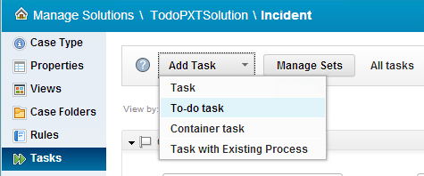
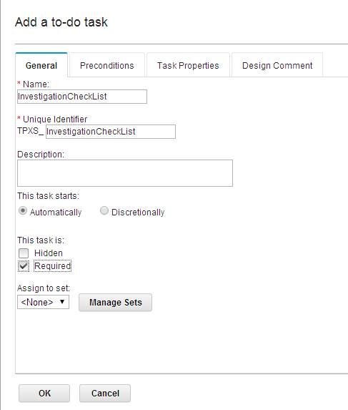
Add To-do Task in Case Builder
To-do task can be started automatically or at the discretion of the case worker.
Note: “Manual” type is not supported.
To-do task can be marked as required or hidden.
Note: Hidden to-do will not be displayed on to-do list widget(grid and add to-do action).

Slide 8
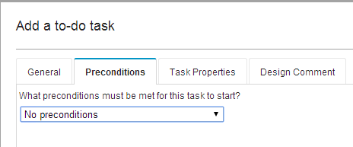
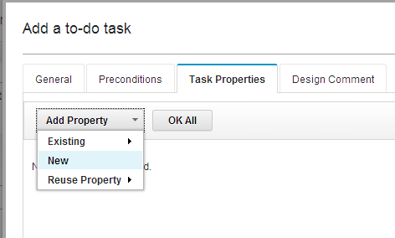
Add To-do Task in Case Builder – cont’d
To-do task can have preconditions in the same way that other tasks can
To-do task can have task properties.

Slide 9
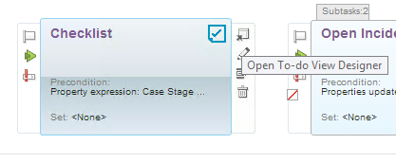
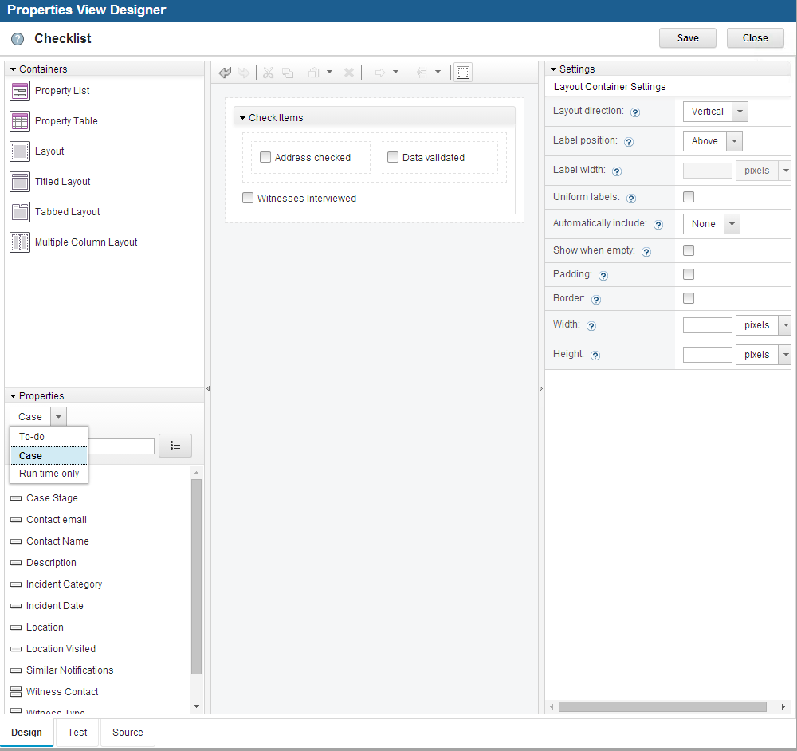
Design Properties view for To-do tasks
Each To-do task can have only one properties view.
Both To-do task properties and case properties can be added to the same view.
The view is used to render the To-do task in To-do list widget.

Slide 10
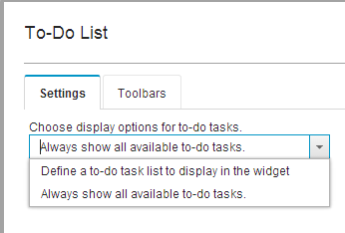
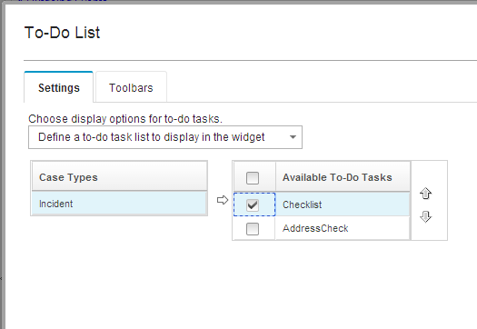
Configure To-do List Widget
By default, the To-do List widget displays all To-do tasks associated with a case.
The task type to display in the To-do list is defined at the Case type level by choosing the option – “Define a to-do task list to display in the widget”.
Default option

Slide 11
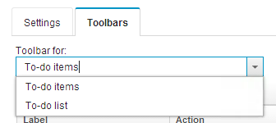
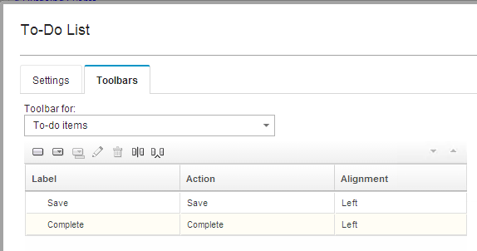
Configure To-do List Widget – Actions
Two toolbars are defined in the To-do list widget
To-do list toolbar
To-do item toolbar
Default buttons in To-do list toolbar
Add To-do task
Refresh
Default buttons in To-do item toolbar
Save
Complete
Note:
The To-do task can also be disabled/enabled/restarted

Slide 12
Course Roadmap
Overview
Configure To-do task in Case Builder
To-do List widget
Customization/API Overview
Course Summary

Slide 13
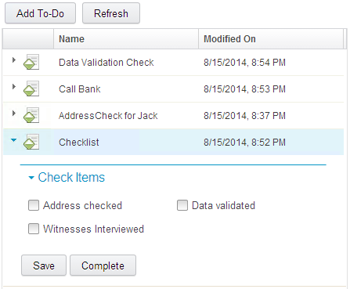
To-do List Widget
To-do List widget displays the To-do tasks of a given case.
By default it displays all non-hidden to-do tasks belong to a case in ‘Working’, ‘Completed’ or ‘Failed’ state.
Which task types should be displayed can be further configured in widget setting at case type level.
Each To-do task is a row in the grid.
Expanding the row displays the task using the configured view layout.
If no view is designed, a system-generated view is used and only task properties are shown.
Clicking on a Grid column header sorts the task rows.

Slide 14
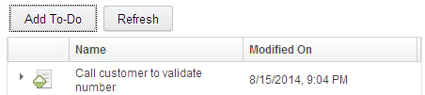
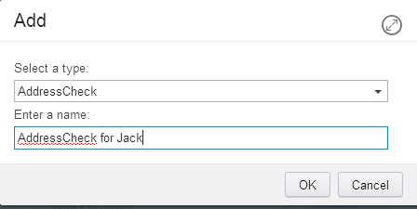
To-do List Widget –To-do list toolbar
To-do list widget toolbar can be used to create a discretionary to-do task or to refresh the list of tasks.
Discretionary To-do task can be created at runtime
Newly added To-do tasks are added at the top of the grid.
Note: May need to refresh to match the sorting.
Refresh will reload the To-do list widget.

Slide 15
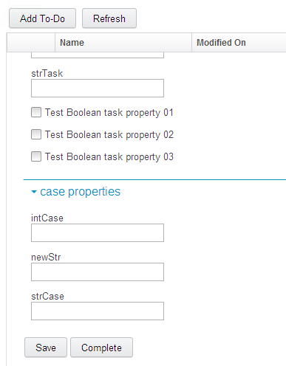
To-do List Widget – To-do item toolbar
To-do task toolbar can be used to operate on individual to-do tasks.
Save action will save changes on a to-do task view, both to-do task properties and case properties on the view.
Complete will save the changes (if any) and move the to-do state to complete.
There are some other actions can be configured to to-do task toolbar:
Disable: moves a working to-do task to failed state.
Restart: moves a failed to-do task back to working.
Close: close the to-do task view, equivalent to click the twisty.

Slide 16
Course Roadmap
Overview
Configure To-do task in Case Builder
To-do List widget
Customization/API Overview
Course Summary

Slide 17
To-do List widget customization – Events
To-do list widget handles the following events:
icm.SendCaseInfo
icm.SendWorkItem
icm.SelectCase
icm.ToDoTaskAdded
icm.RefreshToDoTaskList
Custom settings can be added in the payloads:
propertyList: An array object that represents which task properties should be returned on calling search to-do task API.
gridStructure: An object which is used as the structure of grid to show to-do list.
propertyFilter: A string object representing the conditions on calling search to-do task API.
resultDisplay: An optional javascript object that defines the display attributes of the returned results. For example: {sortBy: "DateCreated", sortAsc: false}
includeHidden: Pass true to include hidden tasks in the results. Otherwise hidden tasks will be filtered out.
Note: propertyList and gridStructure are usually used together to control how tasks are rendered in the grid.

Slide 18
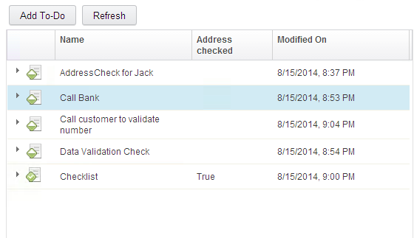
Sample grid structure
var gridStructure = {
"cells": [ [ {
"width": "4.6em",
"sortable": true,
"field": "TaskState",
"name":" "
}, {
"width": "15em",
"sortable": true,
"field": "CmAcmTaskName"
}, {
"width": "5em",
"sortable": true,
"field": "TPXS_Addresschecked"
}, {
"width": "15em",
"sortable": true,
"field": "DateLastModified"
}]]};
Columns, width, sortable can be specified in the gridStructure.

Slide 19
To-do List widget customization – Events – cont’d
To-do List widget publishes the following events via actions:
Actions | Event
icm.action.case.OpenAddToDoTask | icm.ToDoTaskAdded
icm.action.task.StartToDoTask | icm.ToDoTaskStarted
icm.action.task.StopToDoTask | icm.ToDoTaskDisabled
icm.action.task.EnableToDoTask | icm.ToDoTaskEnabled
icm.action.task.RestartToDoTask | icm.ToDoTaskRestarted
icm.action.task.CloseToDoTaskView | icm.ToDoTaskViewClosed
icm.action.task.SaveToDoTask | icm.ToDoTaskSaved
icm.action.task.CompleteToDoTask | icm.ToDoTaskCompleted

Slide 20
To-do List widget customization – Actions customization
To-do List widget provides two toolbars for hosting actions
To-to List toolbar (main toolbar)
To-do toolbar (individual toolbar for each single To-do task)
Context provided by To-do list toolbar
"Case",
"CasePage”, "Solution", "Coordination”
Context provided by to-do task
"ToDoEditable”
"Coordination”
Custom actions can be developed to manipulate the To-do list or individual to-do tasks.

Slide 21
Course Roadmap
Overview
Configure To-do task in Case Builder
To-do List widget
Customization/API Overview
Course Summary

Slide 22
Course Summary
You have completed this course and can:
Describe how To-do lists can be used in Case Manager solutions with non-process tasks.
Create and configure To-do tasks in Case Builder.
Configure the To-do list widget in Case Builder.
Customize the To-do List widget using the events or API.

Slide 23
Contacts
Product Marketing Manager: William (Doc) Mills (wdocmills@us.ibm.com)
Product Manager: Dave Perman (dperman@ca.ibm.com)
Subject Matter Experts (SME)/Area of Expertise:
Ying Ming Gao (gaoyingm@cn.ibm.com)
Gary Guo (guoml@cn.ibm.com)
Support: Ted Dullanty (tdullanty@us.ibm.com)

Slide 24
Product Help/Documentation/Resources
IBM Case Manager 5.2.1 Knowledge Center: http://www-01.ibm.com/support/knowledgecenter/SSCTJ4_5.2.1/com.ibm.casemgmttoc.doc/casemanager_5.2.1.htm
IBM Content Navigator 2.0.3 Knowledge Center: http://www-01.ibm.com/support/knowledgecenter/SSEUEX_2.0.3/contentnavigator_2.0.3.htm
IBM FileNet P8 5.2 Knowledge Center: http://www-01.ibm.com/support/knowledgecenter/SSNW2F_5.2.0/com.ibm.p8toc.doc/filenetcontentmanager_5.2.0.htm?lang=en
IBM Support: Fix Central http://www-933.ibm.com/support/fixcentral/

